Slide 1
Title: Integrating Sign Language Interpretation with Next-Word Prediction
Sub-title:
Bridging Communication Gaps
Presented by :
Debaditya Majumdar Date: 4/3/2024

Slide 2
Outline Of The Project
1. Problem: Communication gap for sign language users.
2. Solution: AI system for sign recognition + next-word prediction.
3.Literature Review
4. System Design: * Capture signs (camera) * Recognize signs (deep learning) * Predict next word (language model) * Display output (text, speech)
5. Implementation: * Develop core modules (recognition, prediction) * Design user interface
6. Evaluation: * Test sign recognition accuracy * Test next-word prediction accuracy
7. Future Work: * Improve data collection for training * Personalize predictions for individual users
8. Impact: Empower sign language users through enhanced communication.

Slide 3
INTRODUCTION
Communication is essential for connection, idea sharing, and relationship building.
Individuals using sign language face challenges in a world dominated by spoken and written language.
These challenges can limit access to information, education, and employment.
Recent AI and ML advancements provide promising solutions to bridge the communication gap.
This paper proposes a novel system combining sign language interpretation with next-word prediction.
The goal is to improve communication for sign language users.

Slide 4
• Deep Learning Powers:
* Sign Language Recognition: Accurately translates gestures into spoken language.
* Next-Word Prediction: Anticipates what the user wants to say next.
• Benefits:
* Simpler Communication: Reduces effort for sign language users to express themselves.
* Improved Accuracy: Fewer errors compared to manual interpretation.
* Enhanced Fluency: Seamless communication by predicting the next word.
• Empowers Sign Language Users:
* Fosters social inclusion and participation.

Slide 5
Problem Statement
"Enhancing Communication for Sign Language Users through AI-Powered Interpretation and Prediction“
Communication Barrier: Sign language users face challenges due to the dominance of spoken and written languages.
AI-Powered Solution: Proposes a system that integrates sign language interpretation with next-word prediction.
Goal: To improve accessibility, fluency, and inclusivity in communication for sign language users.
Impact: Aims to bridge the gap between sign language users and the wider society, enhancing participation and access to information.

Slide 6
OBJECTIVE:
Develop an AI system integrating sign language interpretation with next-word prediction.
Increase communication efficiency and accuracy for sign language users.
Reduce the communication gap with the wider world.
Enhance user experience for more natural and seamless communication.
Foster greater societal inclusion and participation for sign language users.

Slide 7
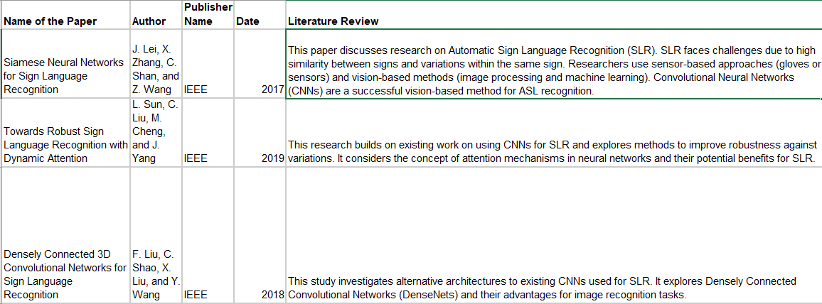
LITERATURE REVIEW:
Literature Review: Integrating Sign Language Interpretation with Next-Word Prediction
Sign Language Detection:

Slide 8
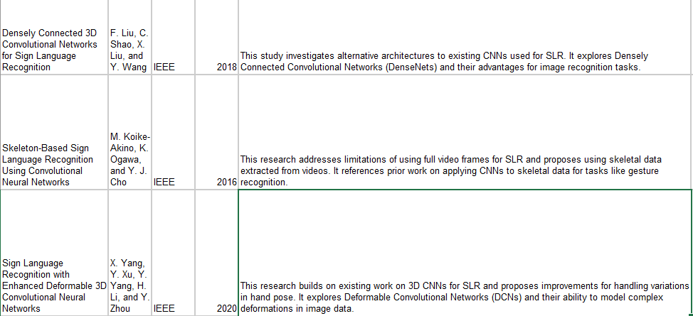

Slide 9
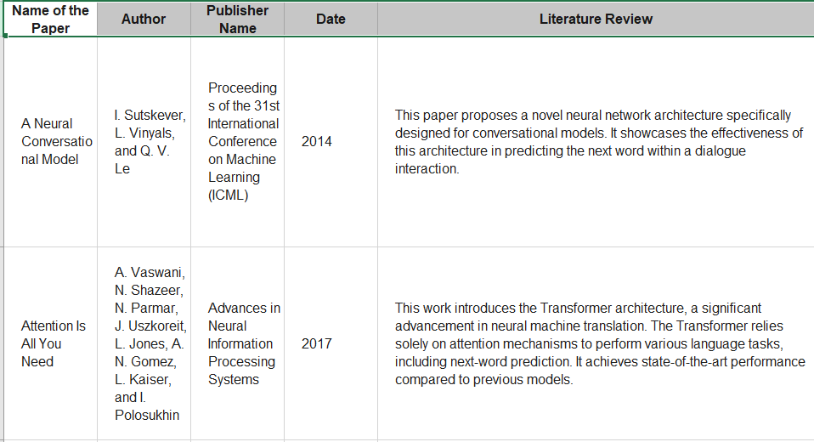
Next Word Prediction: Literature Review
Next-word prediction, also known as language modeling, is a crucial field within natural language processing (NLP) with various applications like text generation and improved user experience in interfaces. Here are six research papers exploring different approaches to next-word prediction:

Slide 10
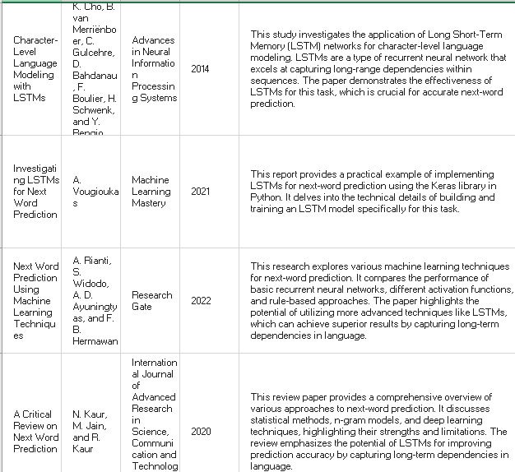

Slide 11
PROPOSED SYSTEM INTRODUCTION:
AI and ML System: Enhances sign language communication for better clarity, efficiency, and flow.
Data Acquisition : Uses advanced cameras or hardware to capture sign language, followed by feature extraction for recognition.
Sign Language Recognition : Employs deep learning (CNNs or RNNs) to accurately interpret sign language data.
Contextual Analysis: Adds precision by analyzing facial expressions, hand positions, and context.
Next-Word Prediction: Utilizes sophisticated language models for predicting the most likely next words, improving communication fluidity.
Output: Displays recognized and predicted words, with an option for text-to-speech synthesis, facilitating easier understanding and interaction.
Enhanced Communication: Offers sign language users improved inclusivity and participation in societal interactions.

Slide 12
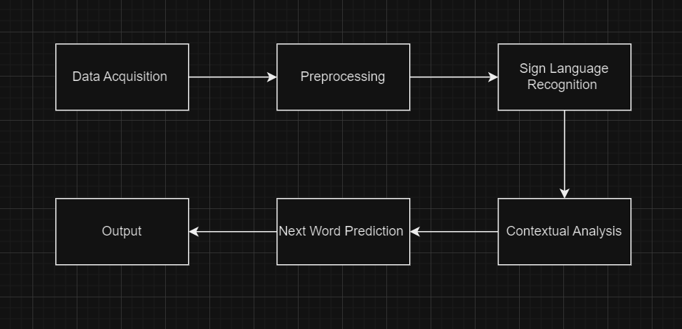
Proposed System Diagram :

Slide 13
The proposed system comprises the following components:
1. Data Acquisition Module :
Captures sign language gestures using a camera or specialized hardware (e.g., data gloves).
Records the video or sensor data of the user's signing movements.
Preprocesses the captured data to remove noise and inconsistencies.
Segments the video into individual signs or frames for analysis.
Extracts key features from the data relevant to sign recognition, such as hand shape, movement trajectory, and orientation. May involve techniques like background subtraction and skeletonization to focus on hand and body movements.
Normalizes the extracted features to ensure consistent data representation.
Creates a structured dataset of sign features with corresponding labels (the actual signs being performed).

Slide 14
2. Sign Language Recognition Module :
Employs deep learning models, such as Convolutional Neural Networks (CNNs) or Recurrent Neural Networks (RNNs).
These models are trained on a large and diverse sign language dataset containing labelled examples of various signs.
The trained model analyzes the preprocessed data (extracted features) from the user's signs.
Identifies patterns within the features that correspond to specific signs.
Outputs the recognized signs with a confidence score indicating the certainty of the prediction.
May handle variations in signing styles and hand placements through robust model architectures.
Continuously learns and improves its recognition accuracy with exposure to new data.

Slide 15
3. Contextual Analysis :
Analyzes additional information beyond hand gestures to potentially improve recognition and prediction.
This might include data like:
Facial expressions that can convey emotions and context relevant to the signs.
Hand position relative to the body for disambiguating similar-looking signs.
Surrounding environment or objects that can provide context.
Utilizes deep learning models trained to recognize facial expressions and hand placements.
Alternatively, rule-based approaches can be used for specific contexts.
Integrates the contextual information with the recognized signs for better understanding.

Slide 16
4. Next-Word Prediction :
Leverages a language model, such as a Recurrent Neural Network (RNN) with Long Short-Term Memory (LSTM) units.
These models are trained on a massive text corpus (collection of written text) to learn language patterns and word relationships.
Receives the recognized signs and contextual information (if available) as input.
Analyzes the sequence of recognized signs and their meaning in the context of the conversation.
Predicts the most likely word(s) that the user intends to communicate next.
Considers the statistical probability of words following each other in a sentence.
Adapts its predictions based on the ongoing conversation and user's signing style.

Slide 17
5. Output Module :
Displays the recognized signs and predicted words on a user interface (screen or other display).
Presents the information in a clear and user-friendly format.
Optionally converts the output to spoken language using Text-to-Speech (TTS) synthesis for broader communication.
Allows users to review and edit the recognized and predicted words as needed.
May provide additional information like confidence scores for both recognition and prediction.

Slide 18
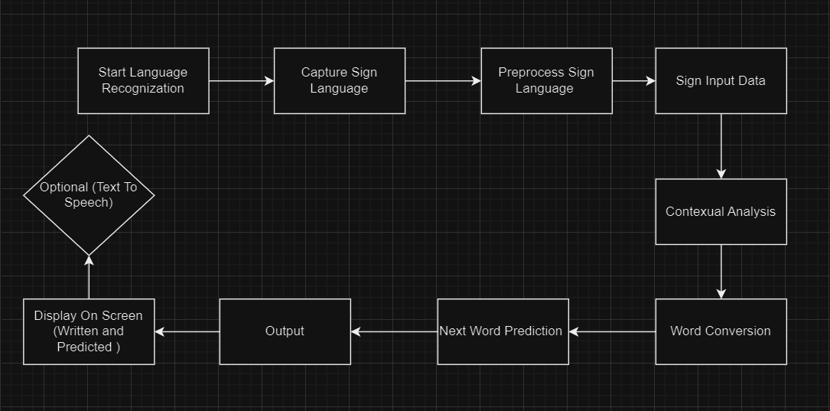
Detailed System Diagram

Slide 19
Challenges and Future Work:
Limited sign language data: Requires continuous efforts to collect and annotate large sign language datasets for training robust models.
Contextual understanding: Incorporating deeper context analysis, such as facial expressions and emotions, to improve sign recognition and prediction accuracy.
Personalization: Adapting the system to individual user preferences and signing styles over time.

Slide 20
Data Set
Directory Structure
Root directory: ./data
Subdirectories for each class (0 to 2)
Each class contains 100 images (0.jpg to 99.jpg)
Image Collection Process
Webcam Access: Utilizes OpenCV (cv2.VideoCapture(0)) to access default webcam.
User Interaction: Press 'Q' to start capturing images for each class.
Image Capture: Auto-captures and saves 100 images per class into respective folders.
Dataset Details
Image Format: JPEG
Image Count: 100 images per class
Usage: Training dataset for image classification models.

Slide 21
Pre Processing
Objective of Pre-Processing
Prepare and clean data to ensure model accuracy and efficiency.
Consistency in Image Format
Convert images from BGR to RGB format using cv2.cvtColor(img, cv2.COLOR_BGR2RGB) for compatibility with image processing libraries.
Data Structure Organization
Images are grouped by class within specific directories.
Ensures structured data access for processing and analysis.
Normalization of Data
Conduct preliminary normalization of image landmarks to align all hands to a common origin.
Essential for reducing variation caused by different image capture conditions.

Slide 22
Feature Extraction
Purpose of Feature Engineering
Transform raw data into meaningful features that significantly improve model performance.
Feature Vector Construction
Compile normalized landmark coordinates into a feature vector (data_aux).
Provides a standardized format for machine learning algorithms.
Utilize MediaPipe Hands for detecting hand landmarks in each image.
Normalization Technique
Extract x, y coordinates of 21 hand landmarks.
Normalize landmark coordinates by subtracting the minimum x and y values in each set (to center data).
Adjust x and y coordinates of landmarks relative to the minimum x and y values.
Enhances model's ability to generalize from the training data.
Transformation of Features
Translate hand landmarks so the lowest landmark is at (0,0).
Maintain relative positions, which is crucial for recognizing patterns in spatial data.

Slide 23
Model Training
Objective of Model Training
Adjust model parameters to best fit the data.
Optimize the learning from training data to predict unseen data accurately.
Selection of Model
Model Chosen: Random Forest Classifier.
Reason: Combines multiple decision trees to improve generalization and reduce overfitting.
Preparing Training Data
Data split into training (80%) and testing (20%) sets using train_test_split.
Ensures data shuffling and stratification for unbiased and representative training.
Fitting the Model
Command used: model.fit(x_train, y_train).
Model learns from the training data by adjusting internal parameters.
Key Parameters
Default parameters used (opportunity for tuning for enhanced performance).
Parameters like n_estimators, max_depth could be optimized in future steps.

Slide 24
Testing
Purpose of Testing
Evaluate the model's accuracy and responsiveness in a real-time environment.
Ensure the model's robustness in recognizing various hand gestures from different users.
Video Capture Initialization
Method: Utilizing cv2.VideoCapture to capture live video feed.
Source: Webcam (device index 0).
Real-Time Hand Landmark Detection
Tools: MediaPipe for detecting hand landmarks.
Configuration: static_image_mode=False for continuous video mode, min_detection_confidence=0.3 to ensure reliable detections.
Processing Video Frames
Frames captured continuously from webcam.
Each frame converted to RGB for MediaPipe processing.
Landmark Detection in Frames
MediaPipe processes each RGB frame to identify hand landmarks.
Features are calculated from these landmarks to prepare for gesture recognition.

Slide 25
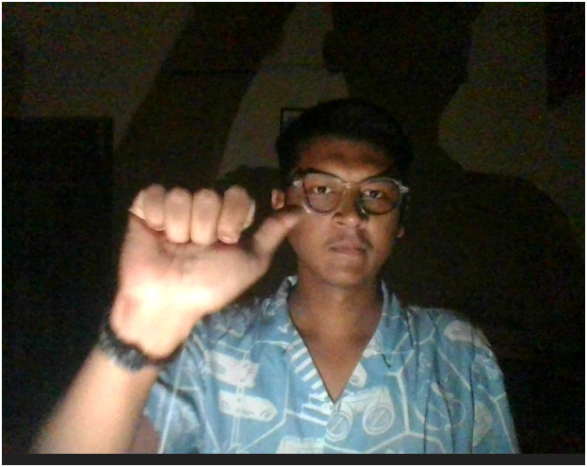
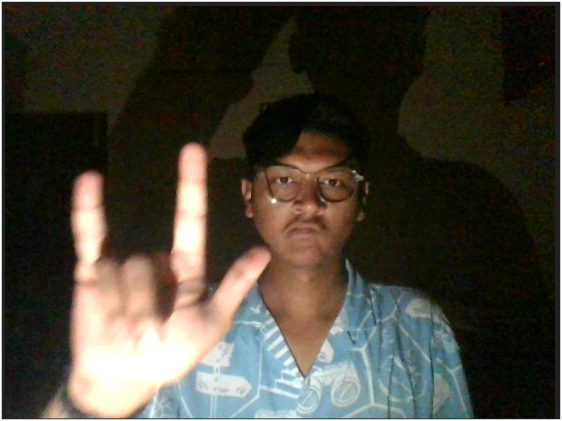
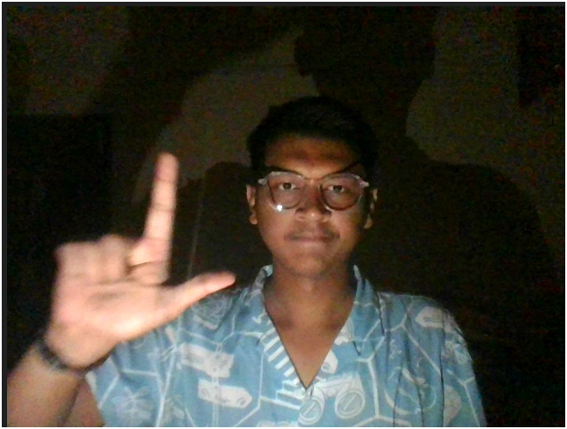
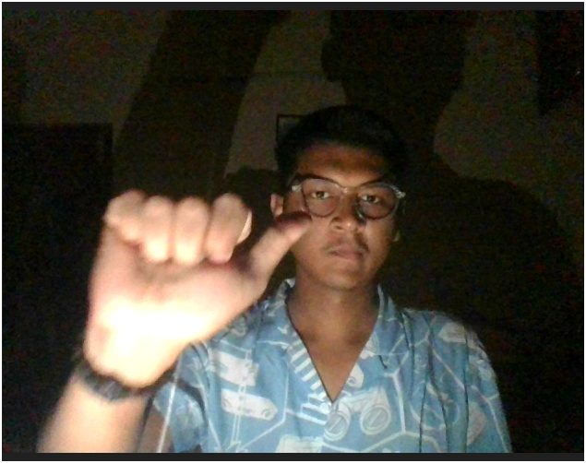

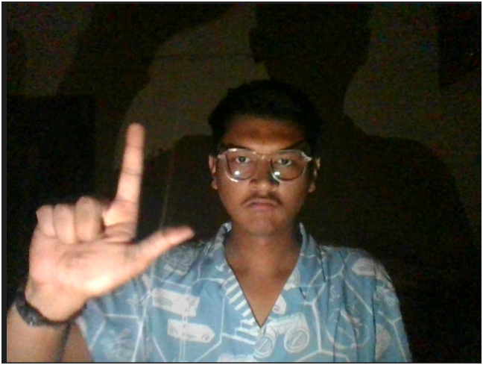
Sample DATA SET
0 1 2

Slide 26
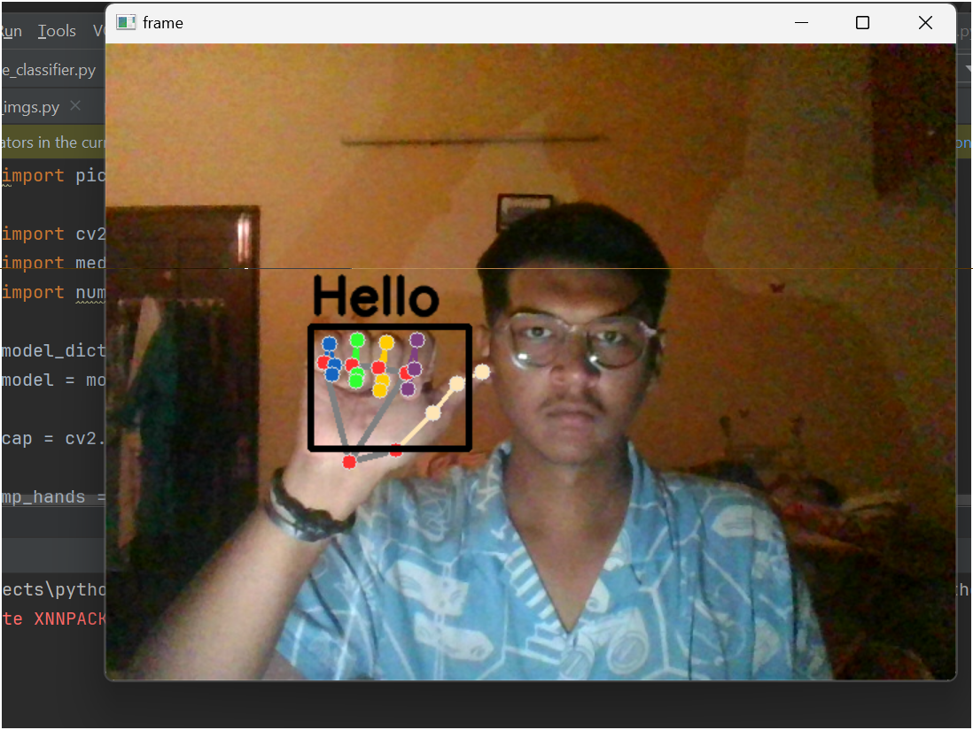
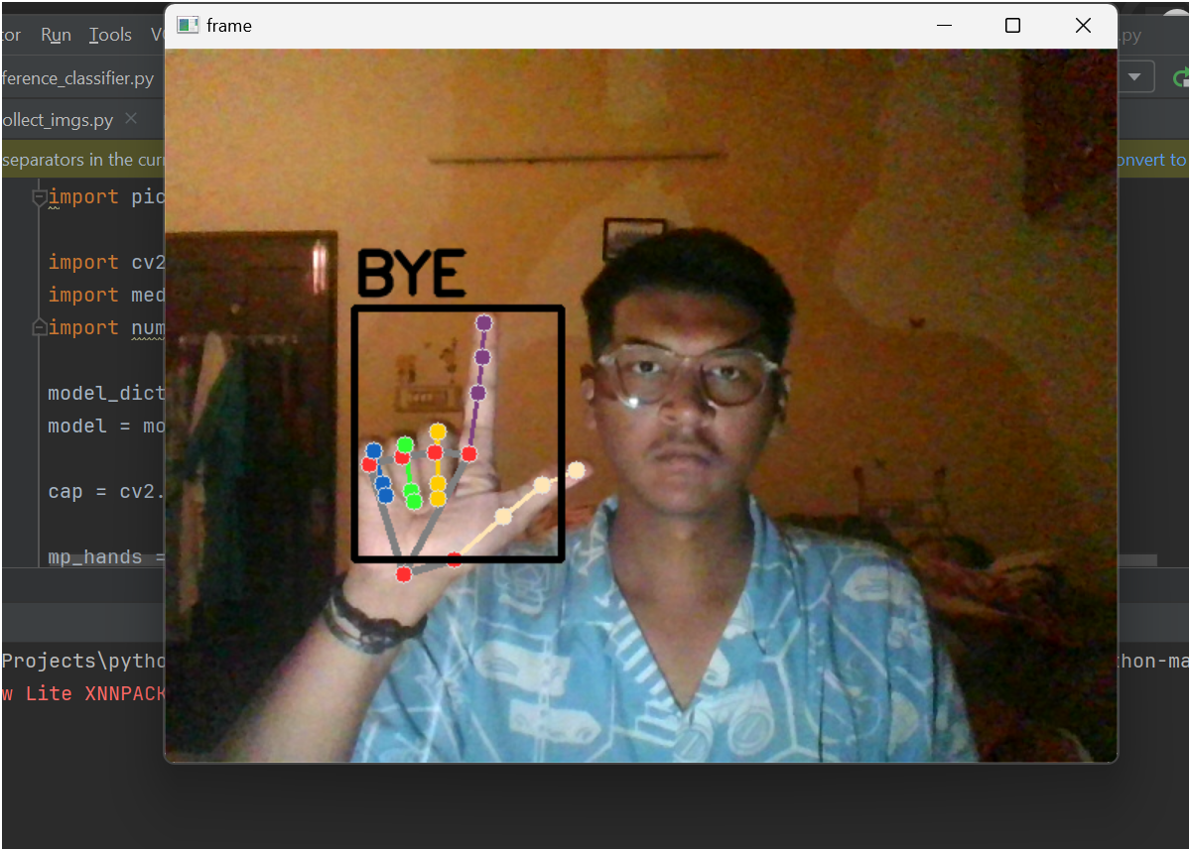
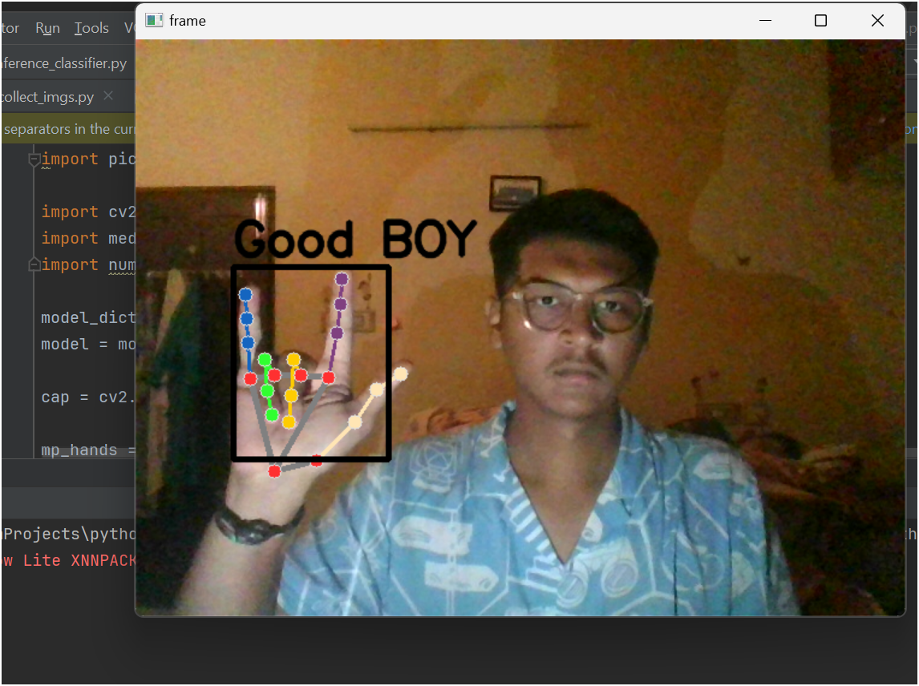

Slide 27
DATA SET
Objective
Collect and label images of facial expressions from a real-time webcam feed for model training.
Setting Up Data Storage
Organize images in directories by emotion labels:Sad, Happy.
Ensures systematic storage for easy access during training.
Capturing Video Frames
Use cv2.VideoCapture to continuously capture frames from webcam.
Real-time interaction with the user.
Label Assignment and Image Saving
User inputs corresponding keys to label current frame with an emotion.
Captured frame is saved under the respective directory based on the label.
Example: Press ‘s' to save the frame as “sad".
Real-Time User Interaction
Display live video feed.
User labels the emotions by pressing designated keys.

Slide 28
PreProcessing
Face Detection
Utilize pre-trained deep learning models (cv2.dnn.readNet) for accurate face detection.
Convert video frame into a blob, process to detect faces, ensuring high precision in diverse lighting and positions.
Image Quality Assurance
Confirm face detection before saving (ensure face_expression is not None).
Adjust bounding box to fit within the frame boundaries to avoid cropping errors.
Grayscale Conversion
Convert captured face region to grayscale:
Focuses on structural features of the face.
Reduces data complexity which aids in model training.
Bounding Box Adjustments
Ensure bounding boxes are well-positioned within the frame to capture the entire relevant area.
Prevents loss of facial feature data crucial for expression recognition.
Visualization and Feedback
Highlight detected face regions on the live video feed.
Provides immediate visual feedback to user, assisting in better positioning and expression capture.

Slide 29
Feature Extraction
Face Detection
Employ pre-trained deep learning model (cv2.dnn.readNet) to accurately detect faces in video frames.
Frames converted to blobs for consistent input to detection models, enhancing detection across various lighting and positions.
Grayscale Conversion
Faces extracted from the video are converted to grayscale:
Purpose: Focus on structural features like edges, contours, which are more prominent without color.
Benefit: Simplifies the model's task by reducing the dimensionality of input data, which can improve processing speed and reduce model complexity.
Feature Normalization
Bounding Box Adjustments: Ensure all faces are well-contained within the frame to maintain consistency in the data set.
Dimension Standardization: Resize all face images to a standard dimension (e.g., 48x48 pixels) to ensure uniformity across all training data.
Data Augmentation (If applicable, not detailed in the previous text but often critical)
Artificially expand the dataset by applying random, realistic transformations to the training images (e.g., slight rotations, scaling).
Enhances the robustness of the model by simulating different scenarios and angles.

Slide 30
MODEL TRAINNG
Model Choosing
Chosen Model: MobileNetV2
Lightweight, efficient CNN designed for mobile and edge devices.
Pre-trained on ImageNet, suitable for image classification tasks.
Customization of Top Layers:
AveragePooling2D: Reduces spatial dimensions.
Flatten: Converts 2D feature maps to a 1D feature vector.
Dense Layers with ReLU activation and dropout for feature learning and overfitting prevention.
Output Layer:
Softmax activation with neurons representing classes for probability distributions.

Slide 31
MODEL TRAINING(CONT)
Splitting Data
Partitioned into training and testing sets (80-20 split).
Stratified sampling ensures representative proportions of each class label.
Training Model
Data Augmentation:
Random zooms, width shifts, height shifts, and shear transformations for increased robustness.
Compilation:
Adam optimizer for adaptive learning rate.
Binary cross-entropy loss for binary labels.
Epochs:
Trained for 50 epochs (complete passes over the training dataset).
Performance Evaluation:
Model evaluated on test set using a classification report.
Detailed metrics include precision, recall, and F1-score for each class.

Slide 32
TESTING
Video Frame Capture and Processing:
Continuously read frames from the video stream.
Resize and convert frames for face detection model compatibility.
Convert to grayscale and back to BGR, resize to 400 pixels width.
Face Detection:
Convert each frame into a blob format suitable for the DNN module.
Apply the face detection model to locate faces in the frame.
Use confidence levels to filter detections below threshold.
Expression Prediction:
Crop detected face regions for processing.
Resize, convert to RGB, and normalize images to match input requirements of the expression recognition model.
Feed preprocessed face images into the model to predict facial expressions.

Slide 33
Training Model Technique
Model Selection:
Adoption of MobileNetV2 as a base due to its efficiency and effectiveness for mobile vision applications.
Transfer learning to leverage pre-trained weights on ImageNet for rapid convergence and improved accuracy.
Model Customization:
Extension of MobileNetV2 with additional convolutional, dropout, and dense layers to tailor it for expression classification.
Use of dropout layers to mitigate overfitting.
Loss and Optimization:
Implementation of categorical cross-entropy loss function, ideal for multi-class classification.
Adam optimizer for adaptive learning rate optimization, facilitating faster convergence.
Model Training:
Training conducted for a predefined number of epochs with early stopping based on validation loss to prevent overfitting.
Usage of real-time data augmentation during training for model robustness.
Performance Metrics:
Tracking accuracy and loss on both training and validation datasets.
Adjustment of parameters based on validation feedback to optimize model performance.

Slide 34








SAD AND HAPPY DATA SET

Slide 35
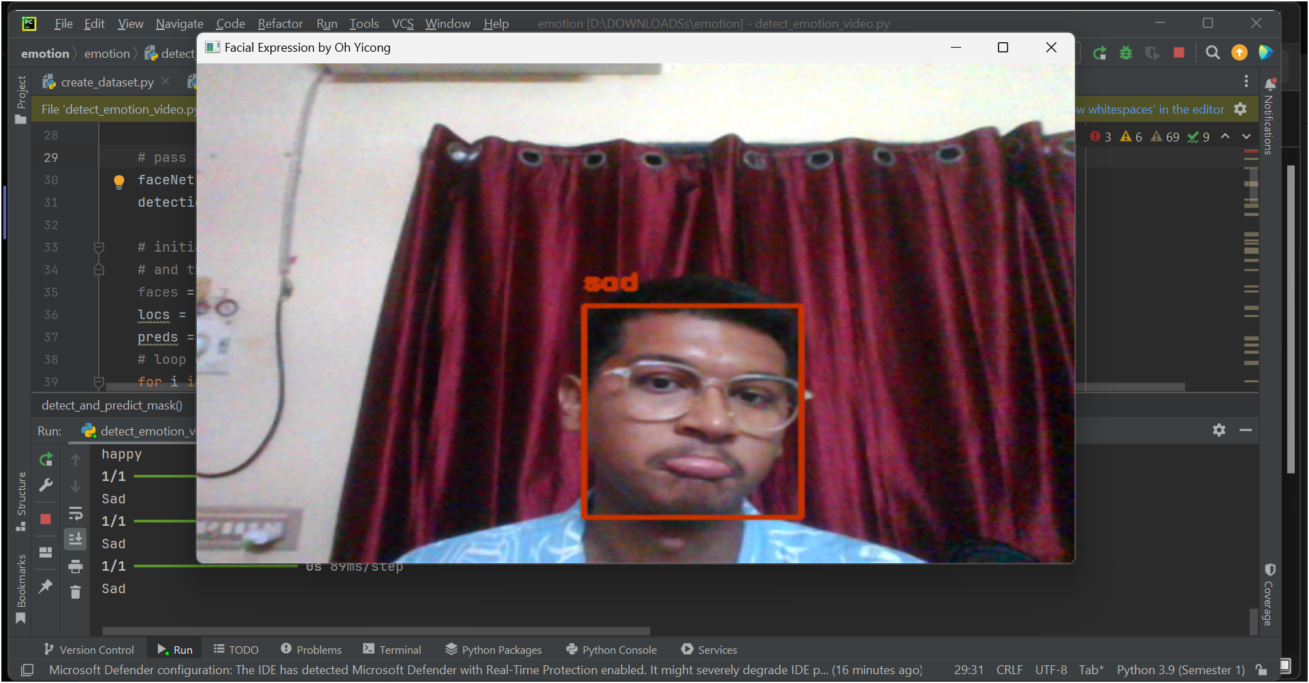
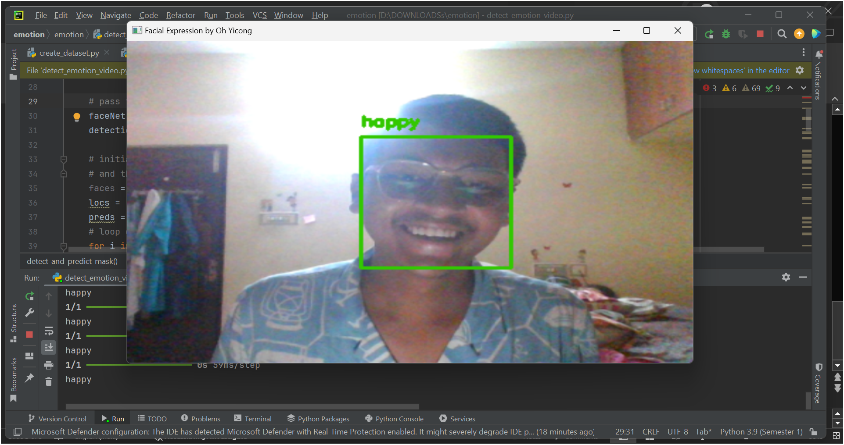

Slide 36
Data Loading
Load Text File:
Open 'blue_castle.txt' with read permissions and UTF-8 encoding.
Read file line by line and append each line to a list.
Data Cleaning:
Remove line breaks, carriage returns, and specific Unicode characters.
Manage whitespace to ensure consistent single space separation.

Slide 37
Data Preprocessing
Tokenization:
Create and fit a Tokenizer from Keras to the text data.
Convert the text into a sequence of integers.
Save Tokenizer:
Serialize the tokenizer using pickle for later use.
Creating Sequences:
Generate sequences of four words (three for input, one for target).
Splitting Input and Target:
Extract input (first three words) and target (fourth word) from each sequence.
One-hot Encoding:
Encode target words into one-hot vectors for model training.

Slide 38
Model Building and Feature Extraction
Define Model Architecture:
Embedding Layer: Converts word indices to dense vectors.
LSTM Layers: Capture long-term dependencies.
Dense Layers: Classification layers with ReLU and softmax activations.
Compile Model:
Use 'categorical_crossentropy' loss and Adam optimizer.
Model Summary:
Summarize model layers, parameters, and output shapes.

Slide 39
Training and Testing
Model Training:
Employ checkpoints to save the best model during training.
Train model using input and target data over 20 epochs with batch size of 64.
Prediction Function:
Define function to predict next word using the model and tokenizer.
Convert text to sequence, predict, and return predicted word.
Interactive Prediction:
Allow user to enter text and predict the next word in real-time.
Continue until user enters '0' to exit.

Slide 40
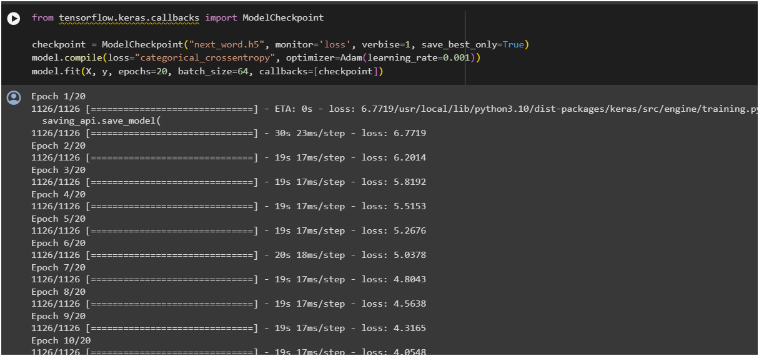
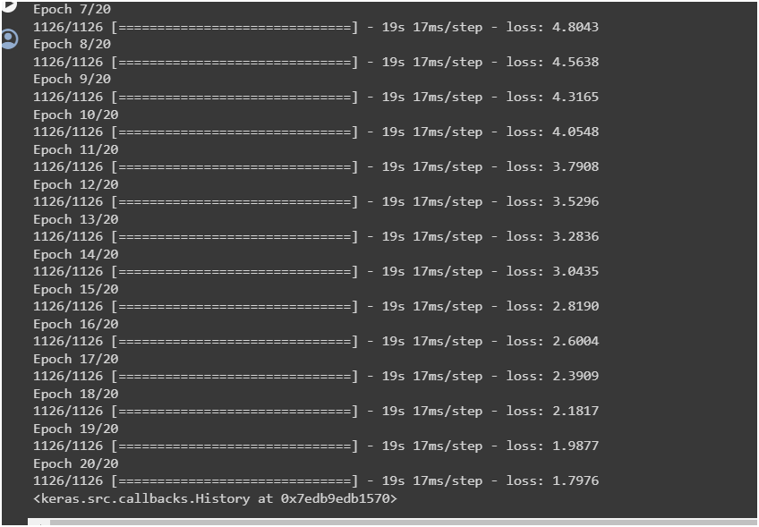

Slide 41
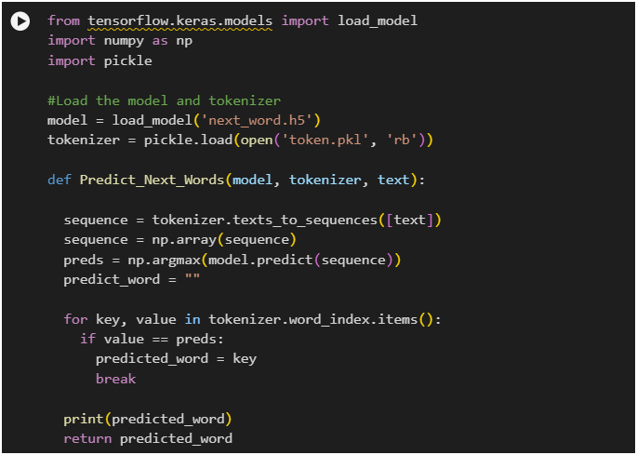
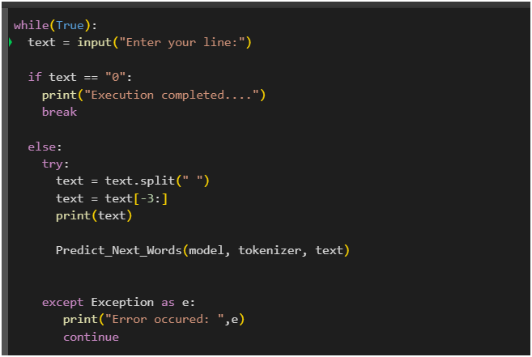

Slide 42
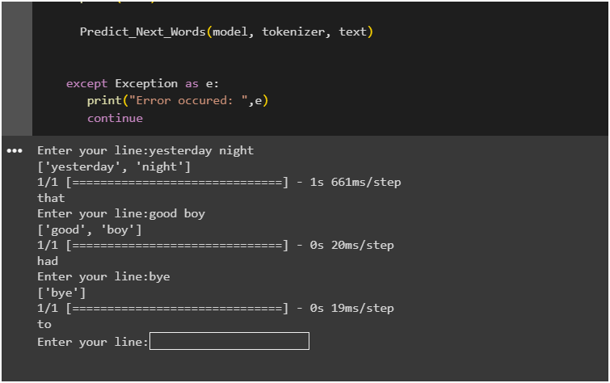

Slide 43
FUTURE WORK
INCREASE THE DATA SET FOR THE SIGN LANGUAGE AND CUSTOMIZE IT ACCORDING TO THE USER
THE ACCURACY OF THE EMOTIUON DETECTION CAN INCREASE USING SOME OTHER MODEL OR INCREASING DATA SET
FOR THE NEXT WORD PREDICTION THE DATASET CAN BE HAVE 2 OR MORE DIFFERENT TYPES OF DATA SET SO IF THE EMOTION IS DEFINED AS SAD, HAPPY , ETC IT CAN PREDICT THE WORK FROM THAT PARTICULAR DATASET.

Slide 44
Thank You

